Slide 1
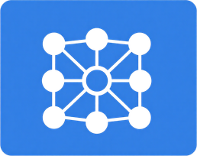


01
What is ERP?
Enterprise Resource Planning (ERP) connects Finance, Supply Chain, Production, Sales, and HR into one unified platform with a shared database, eliminating data silos.
02
Introduction to ERP
Core Modules
Finance · Supply Chain · Production · Sales · Human Resources — all integrated modules sharing real-time data through a single common database.
ERP integrates core business processes into a unified system with a common database, enabling seamless data flow across the organization.
03
Key Benefits
Real-time data access, improved cross-departmental coordination, and enhanced decision support through consolidated operational insights and analytics.

Slide 2
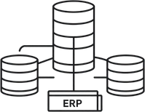


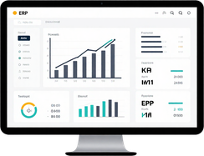
How ERP supports real-time inventory and production information in manufacturing
Integrated Modules & Common Database
Supply Chain, Inventory & Production modules share a single common database for seamless data flow.
Real-Time Transaction Recording
Every transaction instantly updates stock levels and production data across all departments.
Production Scheduling & Inventory Link
Production schedules are dynamically linked with live inventory levels to prevent shortages.
ERP Dashboards & Decision Support
Real-time dashboards provide operational insights, reducing errors and enabling faster decisions.

Slide 3




ERP Integration
Reducing Data Delays and Duplication Across Purchase, Production & Finance
Purchase → Inventory
Purchase transactions automatically update inventory levels and finance records instantly.
01
Single Source of Truth
02
One unified record reduces errors, improves coordination, speed, accuracy and visibility.
03
Unified Platform
Common database enables cross-department data sharing; eliminates silos and duplicate entry.
04
Production Access
Production accesses current material and procurement info in real time; no manual handoffs.

Slide 4
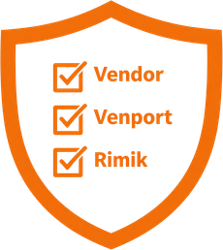



Benefits, Limitations & Success Factors of ERP
Assess ERP benefits, limitations, and critical success factors in large firms.
ERP Benefits
05
Integration of departments, operational efficiency, real-time information access, scalability for growth, and process standardization across the enterprise.
03
ERP Limitations
High implementation cost, system complexity, data migration challenges, user resistance to change, and dependence on a single vendor.
02
Critical Success Factors
01
Top management support, clearly defined project scope, effective change management, comprehensive user training, and a skilled project team.
Risk & Vendor Management
Proactive risk identification and mitigation strategies, along with strong vendor support for expertise, troubleshooting, and long-term system sustainability.

Slide 5
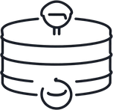

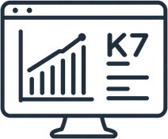

ERP & Managerial Decision-Making
How replacing manual reports with ERP enhances managerial decision-making.
Consolidated Departmental Data
Finance, Sales, HR, Operations & Supply Chain data unified in a single ERP platform.
Standardized Reports Replace Manual
Current, accurate information replaces fragmented manual reports across departments.
Dashboards Show KPIs & Status
Real-time dashboards display financials, payroll, order status, and key performance indicators.
Analytics Enable Better Decisions
Trend analysis, forecasting & what-if scenarios help managers compare targets and act decisively.

Slide 6




ERP & Sales-Production-Inventory Coordination
How ERP improves coordination and efficiency among Sales, Production, and Inventory modules.
Sales Order Triggered
Customer sales orders entered in ERP automatically trigger inventory availability checks across the supply chain.
01
Inventory Check & Procurement
02
Insufficient stock prompts automatic procurement requests or production planning orders to replenish materials.
03
Production Scheduling
Real-time data updates are shared across modules, reducing delays, manual communication, and duplication of effort.
04
Order Fulfilment & Efficiency
Improves order fulfilment rates, resource utilization, accuracy, and operational visibility.

Slide 7



01
Cloud ERP
Scalable, accessible, and cost-efficient. Reduces infrastructure overhead; enables remote access and faster deployment across locations.
02
Emerging Technologies in ERP
IoT & AI Integration
IoT connects sensors for real-time tracking and predictive maintenance. AI enables demand forecasting, fraud detection, automation, and chatbots.
Cloud, IoT & AI are transforming traditional ERP systems with greater agility, automation, and intelligence.
03
Challenges & Considerations
Cybersecurity risks, data privacy concerns, vendor dependence, system complexity, and governance remain key challenges to address.

Slide 8
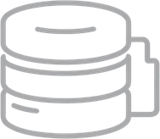


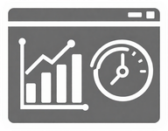
ERP at a Glance
A visual summary of how ERP creates value across the organization.
Common Database
All business data stored in a single, unified repository — eliminating silos and ensuring consistency across departments.
Integrated Modules
Finance, HR, Sales, Supply Chain, and Production modules share data seamlessly through the common database.
Real-Time Updates
Transactions are recorded instantly, keeping inventory, production, and financial data current and accurate at all times.
Dashboards & Better Decisions
ERP dashboards and reports provide KPIs, analytics, and forecasting tools — empowering managers to make faster, informed decisions.

Slide 9




Top Management Support
01
Ensures resources, direction, and organizational commitment for ERP adoption and rollout.
Clear Scope & Change Management
Implementation
Success Factors
02
Defines project goals, limits scope creep, and facilitates user adoption through structured change management.
Key factors that determine successful ERP implementation in organizations.
Training & Skilled Project Team
03
Equips users with necessary skills; a skilled project team drives execution and problem-solving effectively.
Risk Management & Vendor Support
04
Identifies and mitigates risks early; vendor support provides expertise and troubleshooting throughout.

Slide 10




Benefits & Challenges Recap
A visual contrast of ERP's core advantages and key implementation challenges.
Integration & Efficiency
Cost & Complexity
Unifies Finance, HR, Supply Chain & Sales into one platform, eliminating silos and boosting operational efficiency.
High implementation and licensing costs, combined with complex configurations, pose significant financial and technical challenges.
Decision Support & Scalability
Resistance & Data Migration
Real-time dashboards, analytics, and standardized data empower informed decisions and support business growth.
User resistance to change, difficult data migration from legacy systems, and vendor dependence can hinder successful ERP adoption.

Slide 11


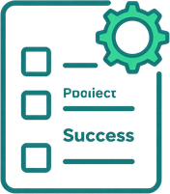

Key Takeaways for Students
Real-Time Integration
Cross-Departmental Benefits
Understand ERP's role in integrating core business processes with real-time data updates across all modules.
Recognize how a common database eliminates data silos and improves coordination across Finance, Sales, HR, and Supply Chain.
Success Factors & Challenges
Emerging Tech in ERP
Know critical success factors like top management support, change management, training, and common challenges such as cost and complexity.
Appreciate how Cloud, AI, and IoT are transforming traditional ERP systems for better responsiveness and automation.

Slide 12
Questions & Discussion
Feel free to ask questions, seek clarifications, or share your thoughts on ERP concepts covered.
Key Takeaway
ERP integrates business processes for real-time data, better coordination, and informed decision-making.
Thank You!
We appreciate your attention and engagement throughout this presentation.
Further Learning
Explore ERP case studies and emerging technologies like Cloud, AI, and IoT transforming enterprise systems.
Contact & Resources
Refer to your MBA Semester III course materials and recommended readings for deeper understanding of ERP.

